Slide 1
Social Entrepreneurship
Per L. Bylund
Robert J. Trulaske, Sr. College of Business
University of Missouri

Slide 2
Social Entrepreneurship
The recognition of a social problem and the subsequent use of entrepreneurial principles to organize, create, and manage a social venture to achieve a desired social change

Slide 3
Issues Targeted
Environmental threats
Poverty
Hunger and starvation
Sickness and health
Illiteracy
Racism
Women’s rights
Homelessness

Slide 4
Social Entrepreneurship: Critiques
“Anti-economic” entrepreneurship
“Social” values higher than monetary profit
Consumption, not production?
Creates conflicts
Value: economic—social
Resource use: efficiency—“ethics”

Slide 5
Kinds of SE
Imitative
“promote social value according to how they qualify for tax-exempt status with the IRS”
Standard, government-sanctioned
Examples: churches, schools, scientific societies

Slide 6
Kinds of SE
Innovative
“emphasis on innovation, or the element of change, … characterizes the enterprise”
Fills market need through non-standard means
Example: micro-loans

Slide 7
Kinds of SE
Nonprofit
Economic outcome “irrelevant”
Consumption
For-profit
Promotes both economic and social value
Examples: Ben & Jerry’s, Grameen bank
Hybrid
Supports social end with earned income
Examples: museum gift shop

Slide 8
Kinds of SE
Imitative Innovative
Nonprofit
For-profit
Hybrid

Slide 9
Kinds of SE
Imitative Innovative
Nonprofit charities, churches philanthr. funding
For-profit Ben & Jerry’s Grameen bank, Kiva
Hybrid part-profit VC for dev. countries

Slide 10
Startup Concerns
Financing
Government contracts
Government grants
Philanthropic grants
Partnerships with for-profit organizations
Evaluating results
Measurement problems
How interpret finances?

Slide 11
Corporate Social Responsibility
A form of corporate self-regulation integrated into a business model
Limited social entrepreneurship as part of for-profit entrepreneurship
Cost or advantage? How assess?
Bylund-Borodin, Journal of Business Ethics (under review )

Slide 12
“Social Business”
Not primarily a charitable organization, but a competitive enterprise – restricted from making losses or paying dividends – working to provide charitable rather than business goals
“operated as a business enterprise, with products, services, customers, markets, expenses, and revenues – but with the profit-maximizing principle replaced by the social-benefit principle” (p. 23)
Example: Grameen-Danone

Slide 13
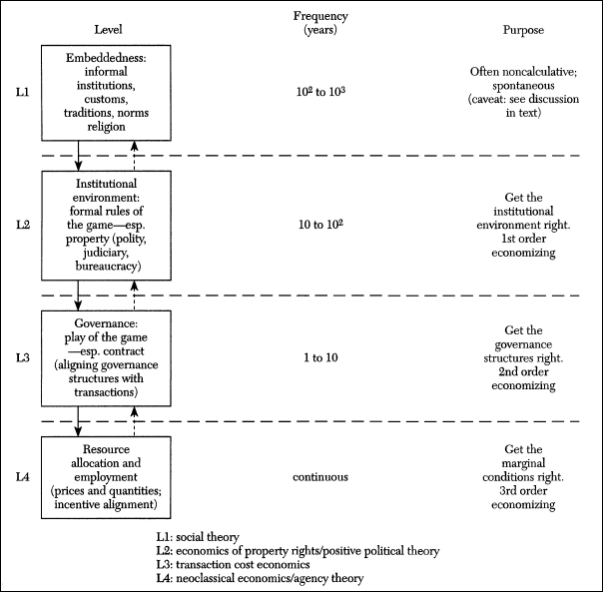
Williamson, 2000, p. 597

Slide 14
Political
Entrepreneurship (Bylund-McCaffrey, Small Business Economics, under review)
Economic (Organizational)
Entrepreneurship
Economic (Trade)
Entrepreneurship
Williamson, 2000, p. 597

Slide 15
Political
Entrepreneurship (Bylund-McCaffrey, Small Business Economics, under review)
Economic (Organizational)
Entrepreneurship
Economic (Trade)
Entrepreneurship
Social Entrepreneurship?
Williamson, 2000, p. 597

Slide 16
Literature Biases
Skepticism or dismissal of economics as “ideological”
Profit, efficiency, and resource allocation as “moral” dimensions/activities
Politically correct
“Many scholars of CSR see the objectives of the firm and the structure of the market as inherently ethical in nature.”

