Slide 1
The Business Model
Per L. Bylund
Robert J. Trulaske, Sr. College of Business
University of Missouri

Slide 2
Business Concept
The product/service
Customer definition
Who values the product?
Who pays for the product?
Who will use the product?
To whom do we sell the product?

Slide 3
Business Concept
Value proposition
Benefit vs. feature of the product/service
What is the value to the customer?
How do we communicate it?
The distribution channel
How do you deliver the value to customers?
The concept: a problem and the solution

Slide 4
Two Sides of the Model
Revenue Model
What shall my price be?
Identify revenue streams
Break down sources of income, dependencies?
Cost Model
COGS
Break-even

Slide 5
Another Two Sides: Value Chain
Upstream
What are my suppliers?
What are my risks/dependencies/costs?
What is the industry like?
Downstream
Who are my customers?
What do I supply?

Slide 6
Concept Quick-test
Am I really interested in this business opportunity?
Is anyone else interested?
Will people actually pay for what is being offered?
Why me?
Why now?

Slide 7
First-Mover Advantage
Meaning:
First in the market
Capture large part of the market quickly
Create “switching costs” for customers
Is the FMA true?

Slide 8
First-Mover Advantage
Video games: Atari → Nintendo → ?
Internet search: Excite → Google → ?
PCs: Apple → IBM → Dell → ?
More examples?
Innovation vs. imitation – discuss

Slide 9
Entry Strategy
Benchmarking
What is the competition like?
Initial market test
(Very) small-scale operation
Seek feedback, search for problems
Create a platform for growth
Platform vs. growth strategy
Scalability

Slide 10
Distribution channel
Inventory
Hold vs. outsource inventory
How time-dependent is the product?
Ownership
Who owns the products in the warehouse?
Financing and payment
Credit terms and times
Methods for collection

Slide 11
Distribution channel
Risk management
Loss or breakage
Product liability
Customer’s failure to pay
What does insurance cover?
Member power
(1) other members rely on A for their primary needs
(2) A controls financial resources
(3) A plays a critical role in value chain
(4) A has no substitute
(5) A has information that reduces uncertainty

Slide 12
Growth Strategy
Franchising (Subway, McDonald’s)
Replicability
Control
Expanding the product mix
Geographic expansion
Regional, national, international growth
Customers? Vendors? Distribution?

Slide 13
Building a Business Model
Identify position in value chain
Upstream actors
Downstream actors
Time from manufacturer to customer
Ultimate retail price and markups
Cost of marketing

Slide 14
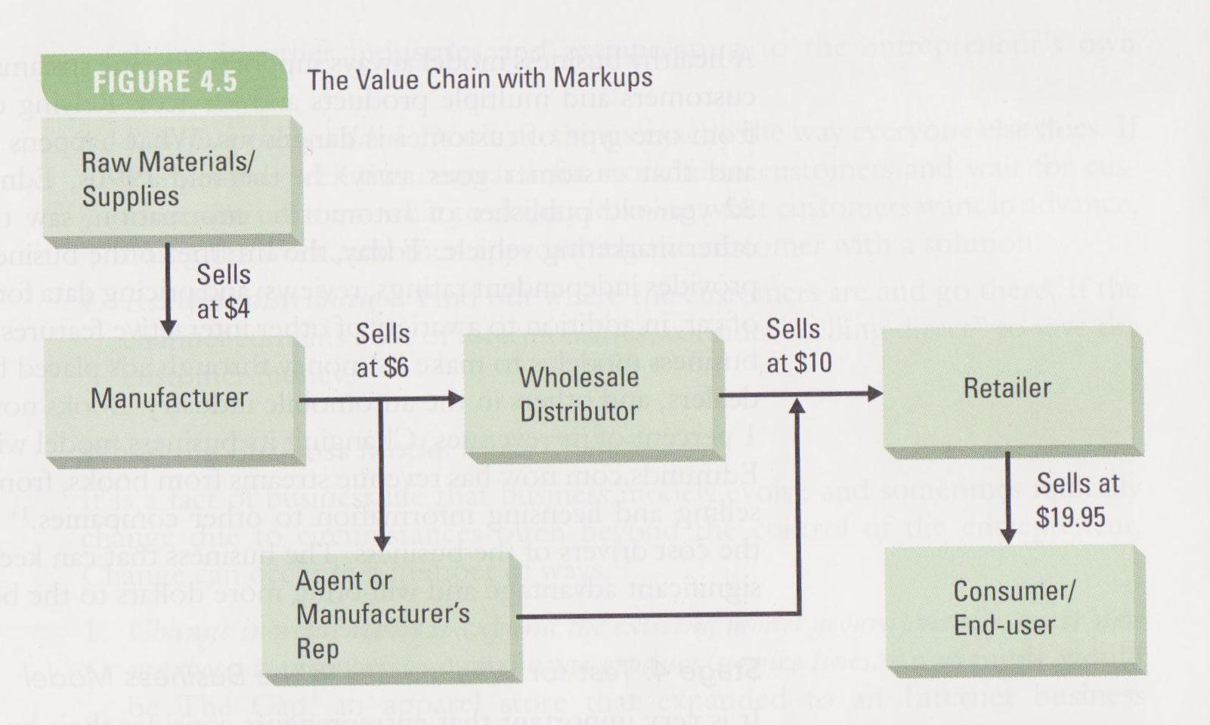
Building a Business Model

Slide 15
Building a Business Model
Identify position in value chain
Upstream actors
Downstream actors
Time from manufacturer to customer
Ultimate retail price and markups
Cost of marketing
Calculate value for customer
Is the benefit “obvious” or is market education necessary?
Identify learning curve
User resistance

Slide 16
Building a Business Model
Revenue and cost drivers
One-source revenue trap
Robustness if markets change
Foreseeable disruptive technologies
Test for weaknesses
Market research
Market testing
Develop competitive advantage
Differentiation-based positioning
Niche-based positioning
Access-based positioning

Slide 17
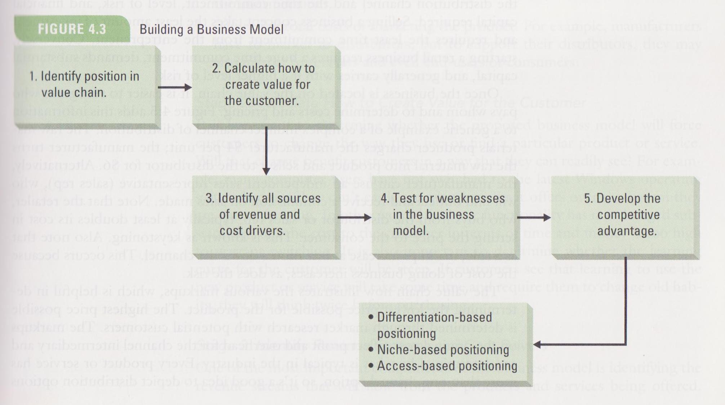
Building a Business Model

Slide 18
Why Business Models Fail
Flawed logic
False assumptions, overlooked problems
Limited strategic choices
Value creation and capture
Imperfect value creation/capture assumptions
Customer vs. user vs. beneficiary
Incorrect assumptions about value chain
Assumed stasis rather than change

