Slide 1
The Business Plan
Per L. Bylund
Robert J. Trulaske, Sr. College of Business
University of Missouri

Slide 2
Before constructing the plan
Recognizing and creating the opportunity
Developing a business model
Conducting feasibility analysis
Analyzing risks and benefits
Building the founding team
Analyzing start-up financials / pro-forma

Slide 3
From feasibility to business plan
Feasibility analysis
Formulates the business idea
Tests the business concept
Business plan is execution-oriented
Reality check for the entrepreneur
Living guide to the business
Statement of intent for stakeholders

Slide 4
What investors want to know
Rate of growth
Return on investment
Degree of risk
Protection

Slide 5
The extended pitch
What need is being served?
Can the founding team serve that need?
Why is now the right time to launch?
What is this venture’s competitive advantage
value, rareness, imitability, substitutability
Can this venture make money?
Why? How? Why Me? Why Now?

Slide 6
Putting it together: action plan
Identify who is responsible for what
Develop a timeline based on tasks identified
Hold the team to the timeline and work diligently to get the plan done

Slide 7
BP Components
Executive Summary
Business Concept
Founding / Management Team
Industry / Market Analysis
Product / Service Plan
Operations or Organization Plan
Marketing Plan
Financial Plan
Growth Plan
Contingency Plan and Harvest Strategy
Timeline to Launch
Appendices

Slide 8
Executive Summary
Include the most important points from all sections of the business plan
Max 2-3 pages
“Sell” with your first paragraph

Slide 9
The Business Concept
What is the business?
Who is the customer?
What is the value proposition?
How will the benefit be delivered?
What is the differentiation strategy?
What is the business model?
What are possible spin-offs? Growth plan?

Slide 10
Founding or Management Team
Qualifications of members
How critical tasks will be covered
Gap analysis – what is missing?

Slide 11
Industry/Market Analysis
Industry analysis
Demographics, major players, trends…
Target market analysis
Demographics, customer grid, market segmentation
Customer profile (primary research)
Competitor analysis and competitive advantages
Distribution channels and risk/benefit
Entry strategy (penetration, customer acquisition)

Slide 12
Product/Service Development Plan
Detailed description of product/service
Technology assessment
Plan for prototyping and testing
Tasks and timeline to completion of prototypes
Acquisition of intellectual property

Slide 13
Operations Plan
Facilities
Business processes
Outsourcing plan
Manufacturing
Distribution

Slide 14
Organization Plan
Philosophy of management, company culture
Legal structure
Organization chart
Key management (roles and profiles)
Duties and responsibilities

Slide 15
Marketing Plan
Purpose of marketing plan
Target market
Market niche
Business identity, image
Plan to acquire first customer

Slide 16
Financial Plan
Summary and capital requirements
Risk factors and solutions
Break-even analysis and payback period
Assumptions for financial statements
Pro forma financial statements, three years
Plan for funding

Slide 17
Growth Plan
Strategy for growth
Resources required
Infrastructure changes

Slide 18
Contingency Plan
Strategies for dealing with deviations and harvesting created wealth
“What to do when stuff happens”

Slide 19
Timeline to Launch
Graphic of tasks and interdependencies, milestones
Gantt chart preferred (use e.g. MS Project)

Slide 20
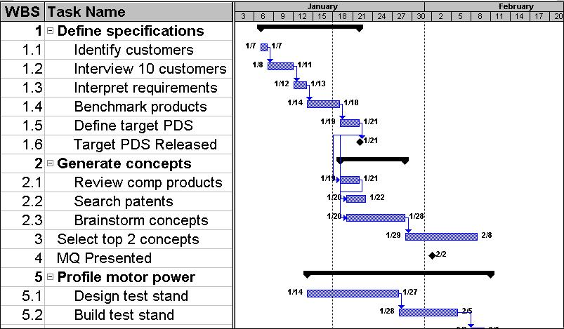
Gantt chart

